Slide 1
Predicting Solar-Readiness
of
NYC Municipal Buildings
DATA 606 Final Project | Qingquan Li
NYC Open Data | City of New York Municipal Solar-Readiness Assessment (Local Law 24 of 2016) data

Slide 2
Abstract
New York City mandates biennial solar-readiness assessments of municipal buildings under Local Law 24 of 2016. This study examines whether observable building characteristics — roof condition, roof age, building size (gross square footage), and borough — are statistically associated with a building's solar-readiness determination.
Using 3,297 assessed NYC municipal buildings from the 2020 and 2022 reporting cycles, we fit a logistic regression model with solar-readiness (Yes/No) as the binary response variable.
Results show that (1) roof condition and building size are the strongest predictors. Buildings with "Good" roof condition have 4.2x the odds of being solar-ready compared to those with "Poor" roofs (p < 0.001). (2) Each unit increase in log(sqft) doubles the odds of solar-readiness (OR = 2.02, p < 0.001). (3) The Bronx has 3x the odds of Manhattan (p < 0.001).

Slide 3
Overview
Data Context
Variables
Source: NYC Open Data, City of New York Municipal Solar-Readiness Assessment (Local Law 24 of 2016) data
Collection: Biennial census of city-owned buildings > 10,000 sqft
Study type: Observational (no experimental manipulation)
Cases: 3,297 assessed buildings (2020 & 2022 cycles)
Dependent (Response):
Solar-Readiness (Yes/No) — categorical, binary
Independent (Explanatory):
1. Roof Condition (ordinal categorical)
2. Roof Age (ordinal categorical)
3. Gross Square Footage (continuous)
4. Borough (nominal categorical)
Research Question: Is there a statistically significant association between a NYC municipal building's roof condition, roof age, building size, and borough — and whether the building is assessed as solar-ready?

Slide 4
Summary Statistics
3,297
3.8%
104,970
73,500
Assessed
Buildings
Solar-Ready Rate
(125 Solar-Ready)
Mean Sq Ft
Median Sq Ft
Roof Condition | N | Solar-Ready | Rate
Poor | 713 | 17 | 2.4%
Between Fair and Poor | 429 | 25 | 5.8%
Fair | 1,151 | 19 | 1.7%
Between Good and Fair | 414 | 11 | 2.7%
Good | 590 | 53 | 9.0%

Slide 5
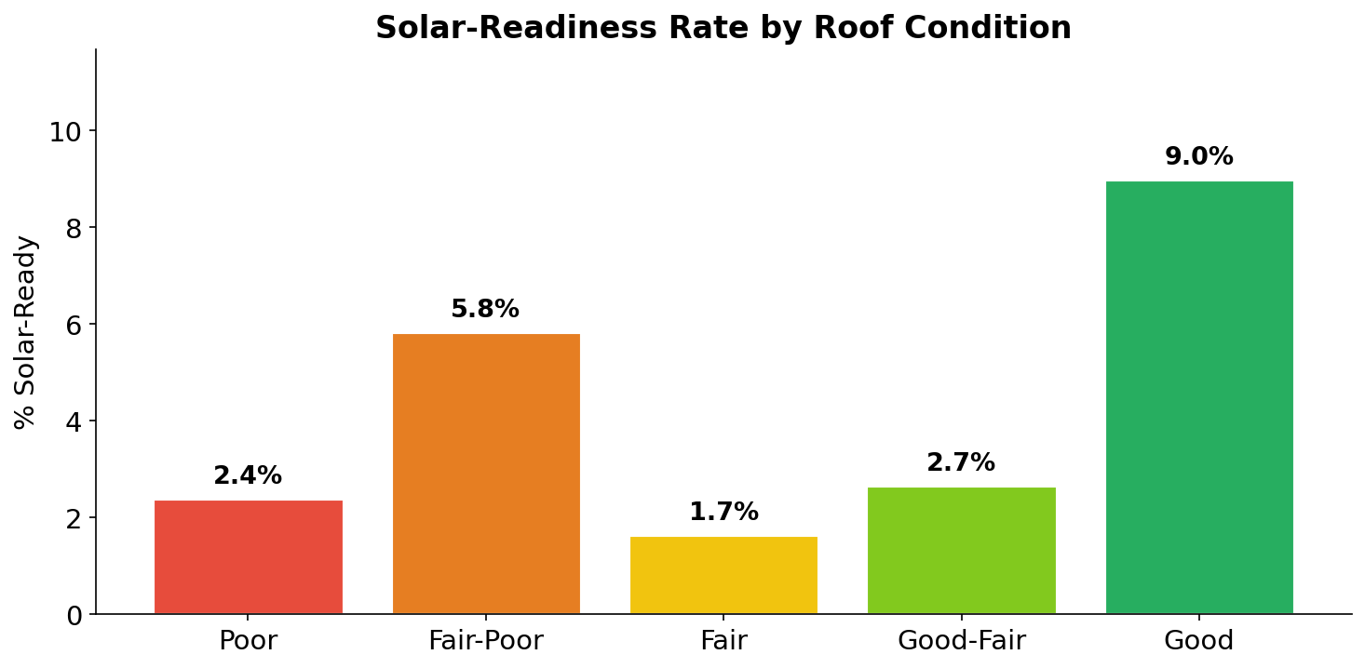
Solar-Readiness by Roof Condition

Slide 6
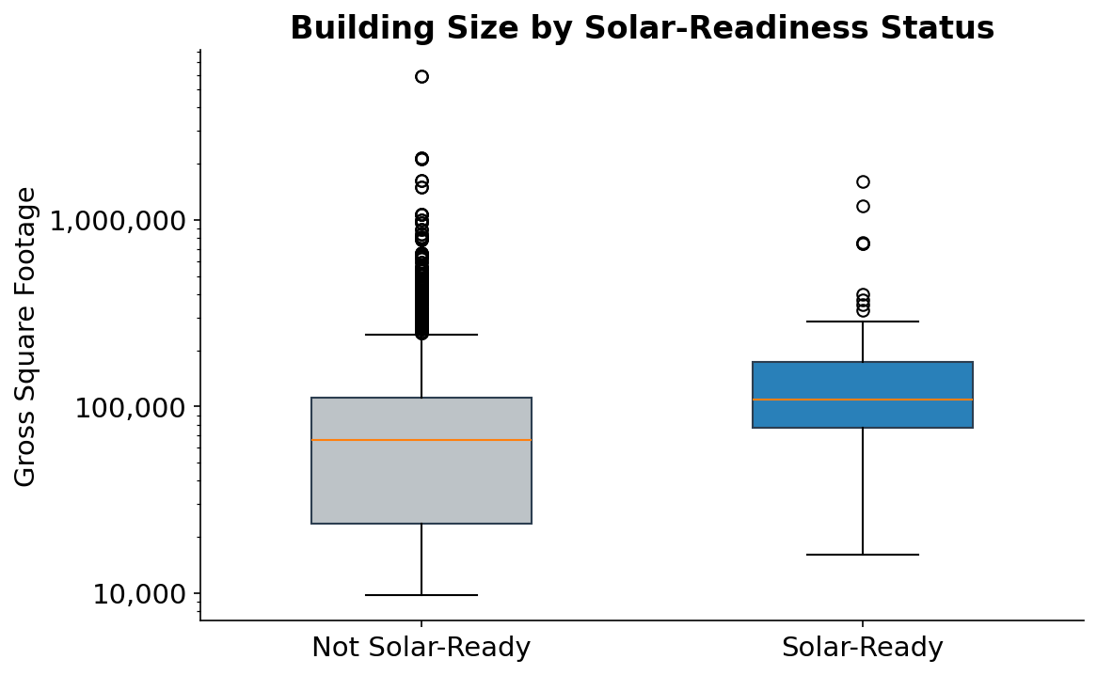
Building Size by Solar-Readiness Status

Slide 7
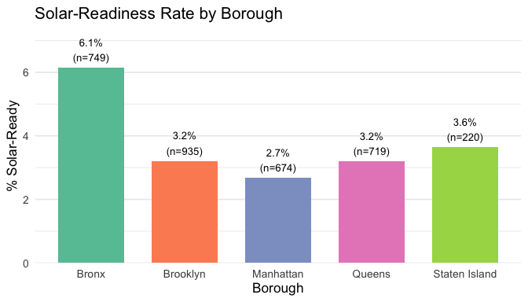
Solar-Readiness by Borough

Slide 8
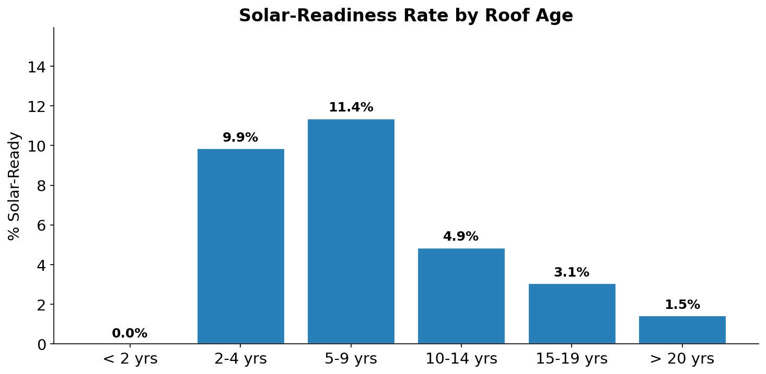
Solar-Readiness by Roof Age

Slide 9
Logistic Regression Results
Model: solar_ready ~ log(sqft) + roof_condition + borough (Reference: Poor roof, Manhattan)
Predictor | Coef | Odds Ratio | z | p-value | Sig
(Intercept) | -12.150 | 0.000 | -10.789 | <0.001 | ***
log(sqft) | 0.702 | 2.017 | 7.887 | <0.001 | ***
Roof: Fair-Poor | 0.776 | 2.172 | 2.356 | 0.018 | *
Roof: Fair | -0.471 | 0.624 | -1.373 | 0.170
Roof: Good-Fair | 0.156 | 1.169 | 0.389 | 0.697
Roof: Good | 1.425 | 4.158 | 4.878 | <0.001 | ***
Boro: Bronx | 1.106 | 3.023 | 3.676 | <0.001 | ***
Boro: Brooklyn | 0.415 | 1.514 | 1.305 | 0.192
Boro: Queens | 0.280 | 1.323 | 0.840 | 0.401
Boro: Staten Isl. | 0.662 | 1.939 | 1.473 | 0.141
Logistic regression — for yes/no outcomes instead of continuous numbers. It predicts the probability of "Yes" (solar-ready) based on the predictors.
Odds ratio (e.g., 2) — for each unit increase in log(sqft), the odds of being solar-ready roughly double. Above 1 = increases the chance, below 1 = decreases it.
p-value (e.g., 0.001) — there's less than a 0.1% chance this result is a random fluke. It's statistically significant — we're confident building size genuinely predicts solar-readiness.

Slide 10
Key Findings
4.2×
Buildings with Good roofs have 4.2 times the odds of being solar-ready vs. Poor roofs (p < 0.001).
2.0×
Each unit increase in log(sqft) doubles the odds of solar-readiness (OR = 2.02, p < 0.001). Larger buildings are more viable.
3.0×
The Bronx has 3× the odds of Manhattan (p < 0.001), possibly reflecting newer roof stock or building types.

Slide 11
Conclusion
Why This Matters
Limitations
NYC has committed to carbon neutrality by 2050. Understanding which building characteristics predict solar-readiness helps the city prioritize roof maintenance and target capital investments to expand rooftop solar across its municipal portfolio. Improving roof conditions from Poor/Fair to Good could unlock solar potential on hundreds of additional city-owned buildings.
1. Only 3.8% of buildings are solar-ready — severe class imbalance may affect model sensitivity.
2. Observational design — cannot establish causal relationships.
3. Only municipal buildings — results may not generalize to private buildings.
Data: NYC Open Data — City of New York Municipal Solar-Readiness Assessment (Local Law 24 of 2016)
https://data.cityofnewyork.us/City-Government/City-of-New-York-Municipal-Solar-Readiness-Assessm/cfz5-6fvh

